Slide 1
Customer churn prediction in a telecom industry using SQL, power BI or tableau
- PARIMALA GOWRI S (MBE11)

Slide 2
agenda
Introduction
Data collection
Data Preprocessing
Exploratory data analysis
Feature engineering
Visualization and reporting

Slide 3

introduction

Slide 4
introduction
In the highly competitive telecom industry, retaining customers is as crucial as acquiring new ones. Customer churn, which refers to the phenomenon of customers discontinuing their services with a company, is a significant challenge for telecom providers.
Predicting churn allows companies to identify customers at risk of leaving and take proactive measures to improve customer retention.
This project leverages SQL and data visualization tools like Power BI or Tableau to predict and analyze customer churn. SQL is used for data extraction, transformation, and cleaning, enabling the creation of a reliable dataset for analysis.
Power BI or Tableau further enhances the process by providing visualizations that help stakeholders interpret data trends, track churn drivers, and explore insights interactively.

Slide 5
Data COLLECTION

Slide 6
Data collection
I extracted the data using SQL query by creating a new schema named Customer_churn and imported the table into the schema using the given Customer_churn.CSV text file.
The Customer ID datatype given in the table is in the incorrect datatype format as Text so there is a need to change the data type format.
The file is not working properly so I parsley corrected the file using ChatGPT and then using SQL I extracted the data, there is a space between the words in the column name so there is a need to change the words in the column name eg: customer id into customer_id
Now again I worked with SQL, first I imported the table through table import wizard
“Select*from customer_churn”
I extracted the data using this code

Slide 7
Data preprocessing
Documentation

Slide 8
Data preprocessing
I cleaned the data where it needed to be changed, eg: I changed the data type format of “Customer_id” from text to varchar as it contains an alphanumeric value.
I used the code
“ALTER TABLE customer_churn
MODIFY Customer_ID VARCHAR(50);”
I checked the values of null using the code
“Select customer_id from customer_churn
where Customer_ID is null;
As it contains no null values
The data is cleaned right now

Slide 9
Data analysis
IDENTIFY THE TOTAL NO OF CUSTOMERS AND CHURN RATE
“select count(*)from customer_churn;”
select count(*) as customer_id
from customer_churn
where customer_status = 'churned’;”
I used this code to identify the total no of customers and total no of churned customers
I used another code to find the churn rate, that is given on the next slide as follows:

Slide 10
Data analysis
WITH customer_base AS ( -- Total number of customers at the start of the period (e.g., Sept 2024)
SELECT COUNT(Customer_ID) AS total_customers_at_start FROM customer_churn1),
churned_customers AS ( -- Number of customers who churned during the period (e.g., Sept 2024)
SELECT COUNT(Customer_ID) AS churned_customers
FROM customer_churn1
WHERE Customer_Status='churned’)
– Calculate churn rate
SELECT (churned_customers * 100.0) / total_customers_at_start AS churn_rate FROM customer_base, churned_customers;
According to SQL, The dataset contains a total of 4835 customers. Of these, 1586 have churned, resulting in a churn rate of approximately 32.80%.

Slide 11
Data analysis
FIND THE AVERAGE AGE OF CHURNED CUSTOMERS
select avg(age)from customer_churn
where customer_status = ‘churned’;
Using this code, I found out the average age of churned customers.
The average age of churned customers is approximately 50.1658 years.

Slide 12
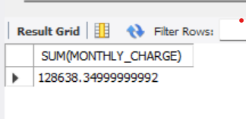
DATA ANALYSIS
DISTRIBUTION OF MONTHLY CHARGES AMONG CHURNED CUSTOMERS:
SELECT Customer_ID, Monthly_Charge FROM customer_churn1WHERE Customer_Status="CHURNED“
I extracted the data using this code
To calculate the distribution of monthly charges, i used the code as follows:
SELECT Customer_ID, Monthly_Charge
FROM customer_churn1
WHERE Customer_Status="CHURNED“;
The distribution of monthly charges among churned customers is 1,28,638.350 rupees

Slide 13
DATA ANALYSIS
A QUERY TO IDENTIFY THE CONTRACT TYPES THAT ARE MOST PRONE TO CHURN:
SELECT
Contract,
COUNT(*) AS Total_Customers,
SUM(CASE WHEN Customer_Status = 'Churned' THEN 1 ELSE 0 END) AS Churned_Customers,
ROUND(
SUM(CASE WHEN Customer_Status = 'Churned' THEN 1 ELSE 0 END) * 100.0 / COUNT(*),
2
) AS Churn_Rate
FROM customer_churn
GROUP BY Contract
ORDER BY Churn_Rate DESC;

Slide 14
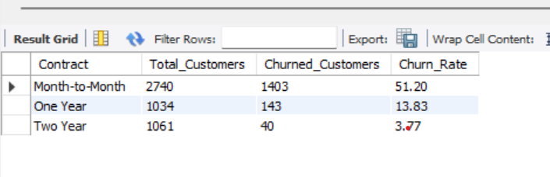
Data analysis
The churn rates by contract type are as follows:
Month-to-Month: 45.84%
One Year: 13.83%
Two Year: 3.77%
2. Insights:
Month-to-month contracts have the highest churn rate, indicating that customers with more flexible terms are more likely to leave.
Two Year contracts show the lowest churn rate, suggesting longer commitments reduce churn.
This pattern is typical, as shorter-term contracts provide customers with more freedom to switch, while longer contracts encourage retention through commitment and possibly discounts.

Slide 15

DATA ANALYSIS
CUSTOMERS WITH HIGH TOTAL CHARGES WHO HAVE CHURNED
“SELECT CUSTOMER_ID, TOTAL_CHARGES FROM CUSTOMER_CHURN1 WHERE CUSTOMER_STATUS='CHURNED'ORDER BY TOTAL_CHARGES DESC;”
I used the above code to extract the data, the customers who have churned with high total charges

Slide 16
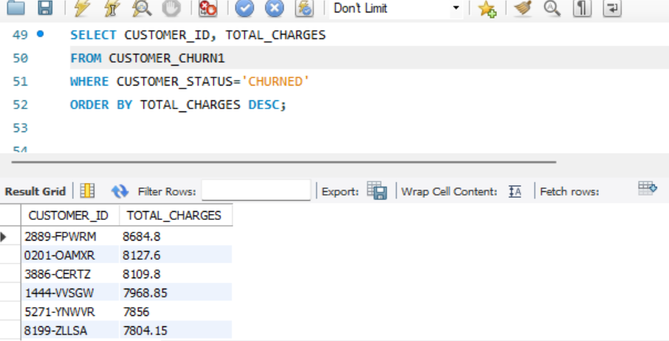
DATA ANALYSIS

Slide 17
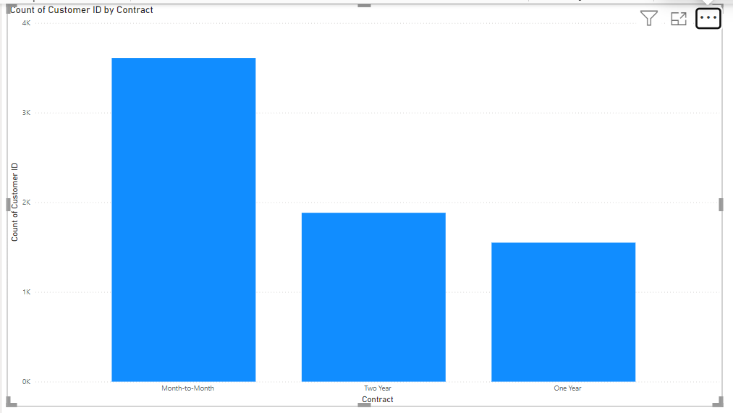
Exploratory data analysis by power bi DATA ANALYSIS
DISCOVER MOST COMMON CONTRACT TYPES
according to Power BI bar chart, the most common contract types is month - to- month

Slide 18
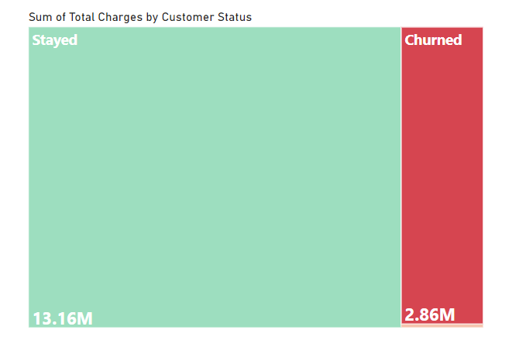
Exploratory data analysis by power bi
THE TOTAL CHARGES DISTRIBUTION FOR CHURNED AND NON-CHURNED CUSTOMERS:
Here is the total charges distribution by customer status:
Churned: $2,862,926.90
Joined: $35,998.90
Stayed: $13,161,799.44
Total charges distribution for churned customers = 2.86M
Total charges distribution for non-churned customers = 13.16M+35.9K=13,197,798 =13.2M

Slide 19
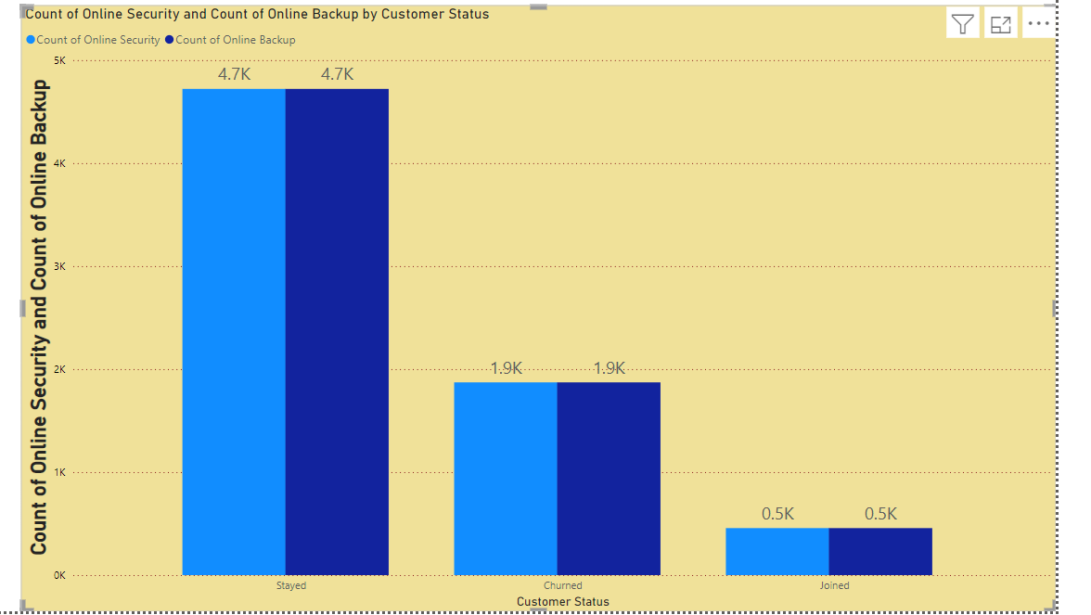
EXPLORATORY DATA ANALYSIS BY POWER BI
CUSTOMERS WHO HAVE BOTH ONLINE SECURITY AND ONLINE BACKUP SERVICES AND HAVE NOT CHURNED
4750 customers have both online security and online backup services and have not churned, analyzed using power bi

Slide 20
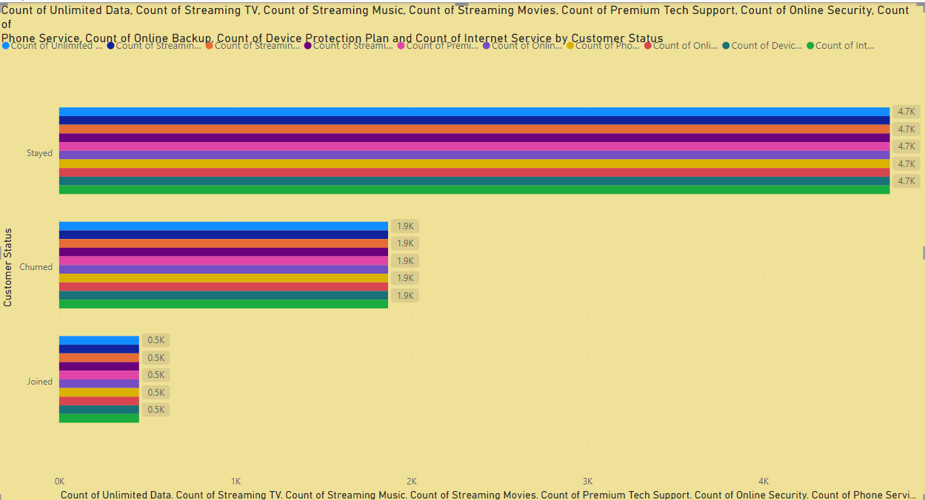
EXPLORATORY DATA ANALYSIS
THE MOST COMMON COMBINATIONS OF SERVICES AMONG CHURNED CUSTOMERS
All services have approximately 1.9k churned customers, I conclude, with the result of all are the most common combination of services.
There is no specific combination of services is common among all the customers

Slide 21
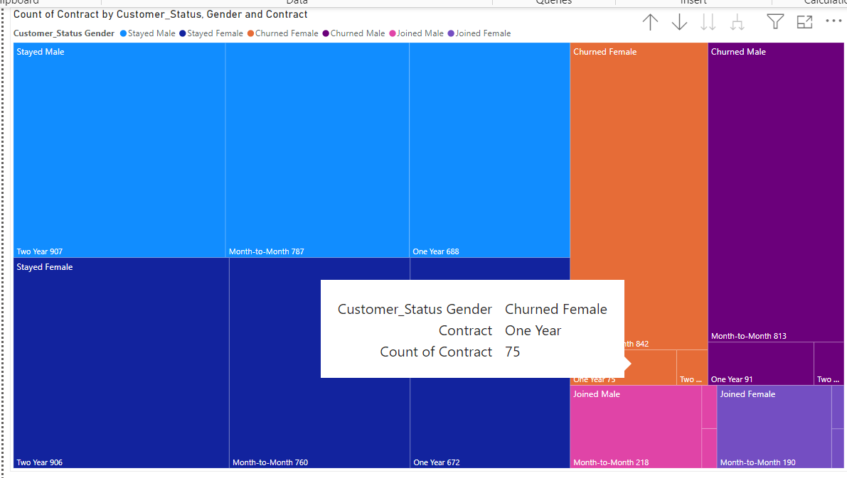
Exploratory data analysis
THE GENDER DISTRIBUTION AMONG CUSTOMERS WHO HAVE CHURNED AND ARE ON YEARLY CONTRACTS
75 Churned females are on a yearly contract
91 churned males are on a yearly contract
22 churned females are on two-year contract
26 churned males are on two-year contract

Slide 22
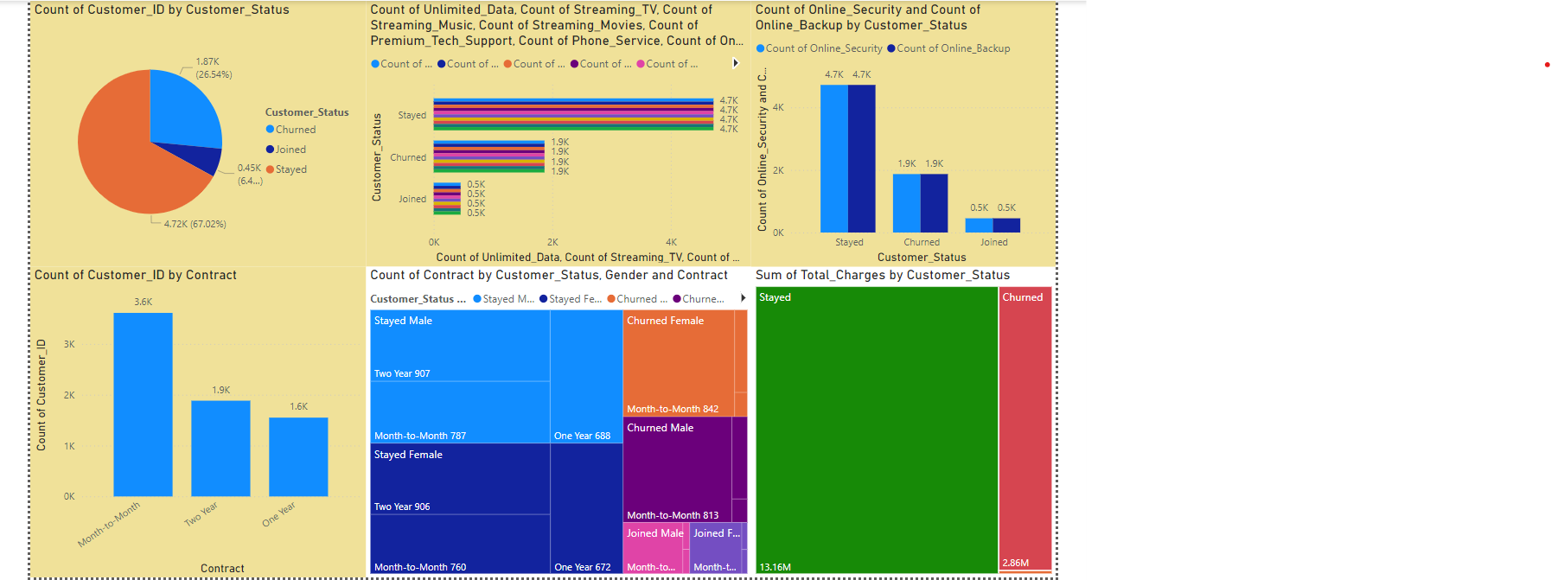
dashboard

Slide 23
STRATEGIC RECOMMENDATIONS TO REDUCE THE CHURN RATE
Improve customer experience
Introduce data-driven customer retention programs
Optimize service plans and pricing
Enhance network quality and reliability
Improve customer on-boarding and education
Leverage feedback and continuous improvement
Long-term contract with incentives
Focus on digital transformation and innovation
Targeted customer segmentation and retention campaigns
Monitor and measure key metrics

Slide 24
Thank you

